Slide 1
MOVIES
An example of a database, routes, and authentication

Slide 2
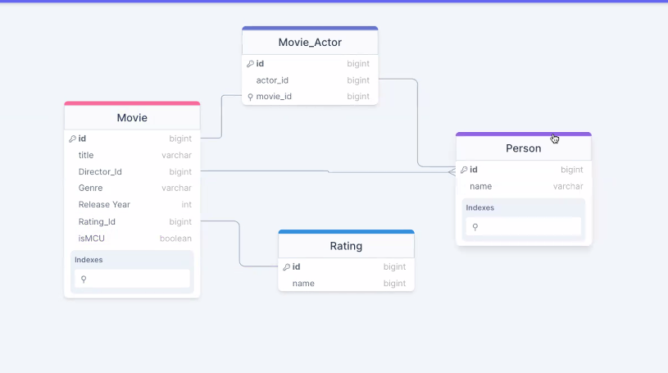
Create schema

Slide 3
Npm init –y
Npm install prisma - - save – dev
Npx prisma init
Create database --- if postgres is installed: createdb dbname

Slide 4
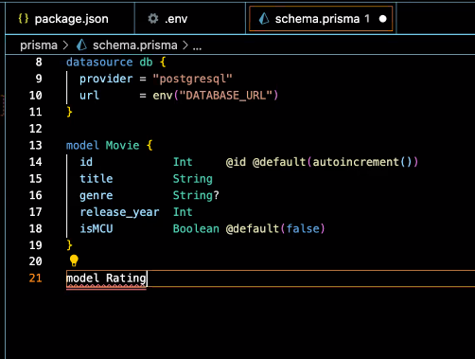
Setting up the Schema
@id says unique and primary key
@default provides default value
@default{autoincrement()} updates for unique id

Slide 5
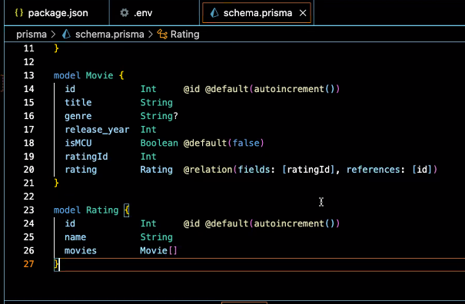
Setting up the Schema
Many to one connection
Sets up relationship between ratingID and the id in the Rating table
Needs to be matched in other table
Pay attention to CAPS to denote tables
Lines 19, 20, and 26 are connected

Slide 6
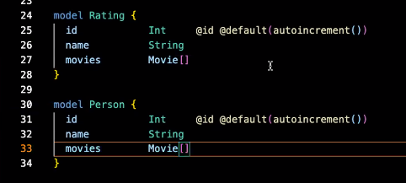
Setting up the Schema
Many to many connection
Lines 27 and 33 are connected many to many

Slide 7
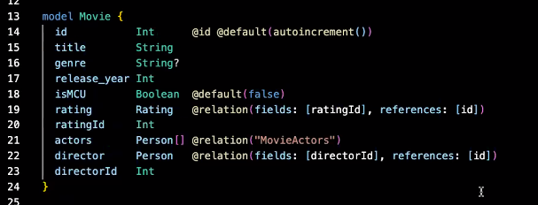
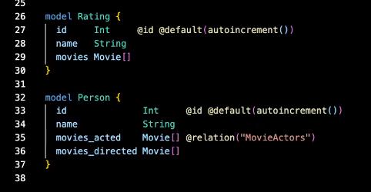
Setting up the Schema
When 2 relations to the same table, need to really define what the connections are

Slide 8
Npx prisma migrate dev - - name init
This will write some sql, create a migration file
Tables are now created in the database
Npx prisma studio -- opens the gui for the database
Create seed.js file

Slide 9
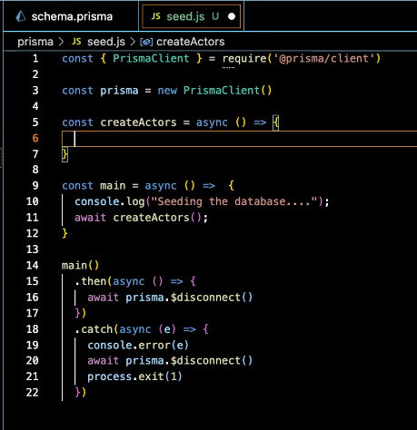
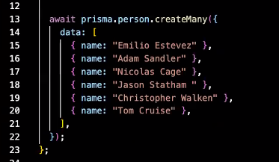
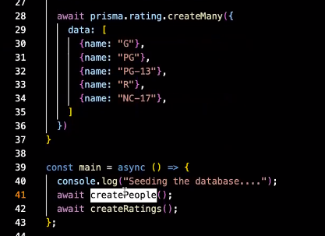
Seed.js
ALL DATABASE OPERATIONS REQUIRE AWAIT

Slide 10
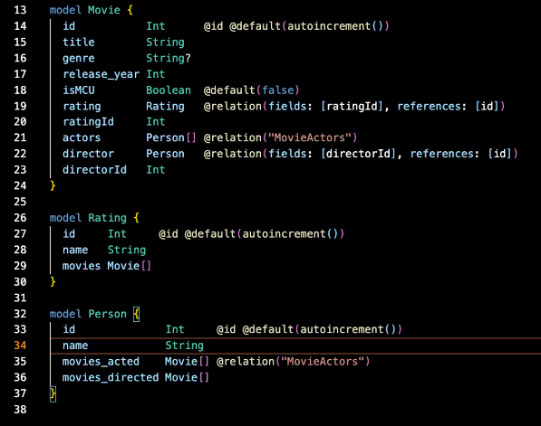
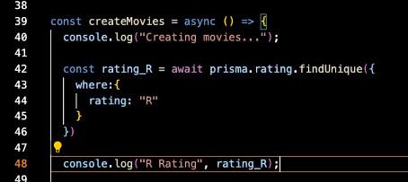
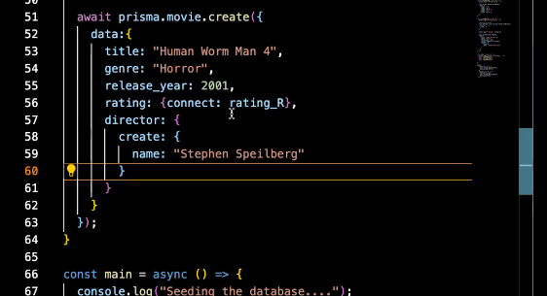
Seed.js

Slide 11
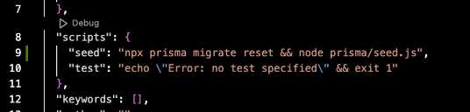
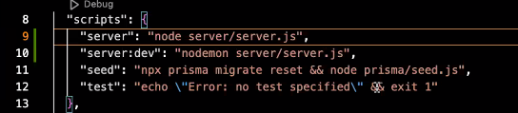
Scripts

Slide 12
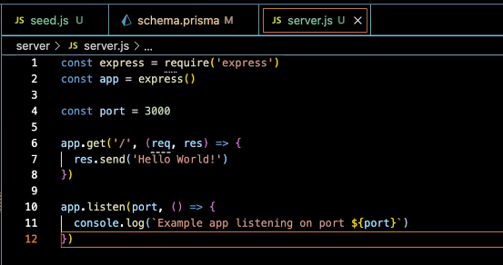
Servers
Create server folder
Create server.js inside
Npm install express
Copy paste from express…
Killall node if nodes are running
Install nodemon - - save-dev
create folder api
Inside api: index.js
then: files for crud based on tables
Starter code for express

Slide 13
Servers
Starter code for express

Slide 14
Morgan
This basically console.logs information about accessing the port
Useful for debugging
Npm install morgan
In server.cjs:
Const morgan = require(“morgan”);
App.use(morgan(“dev”));

Slide 15
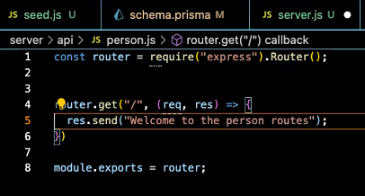
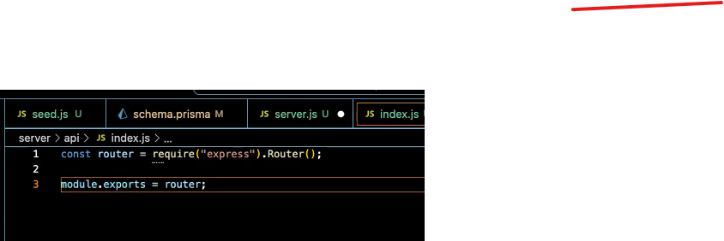
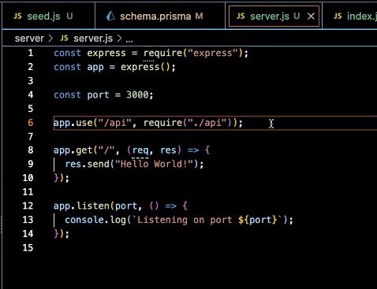
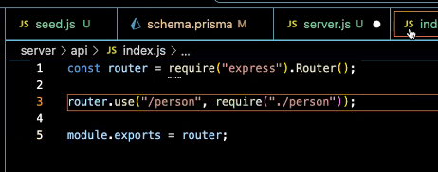



Routes
/api/person.js
Start at Server.js
/api/Index.js
Server.js

Slide 16
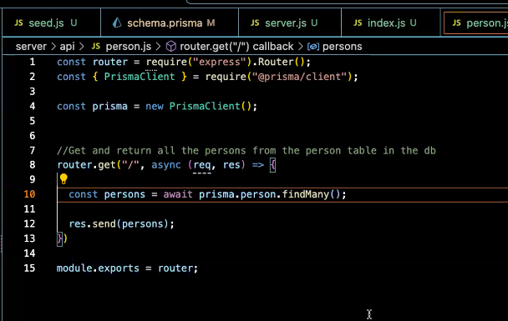
Routes
/api/person.js
Get all persons function

Slide 17
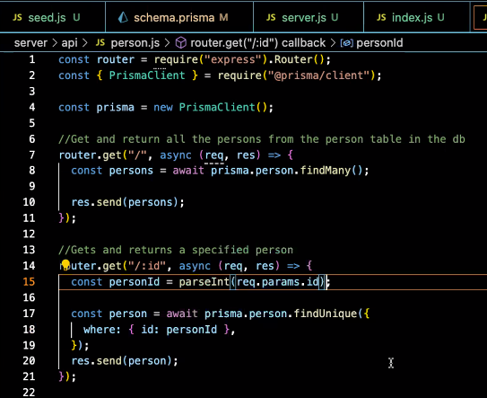
Routes
/api/person.js
Get one person function
Parse to turn string into integer

Slide 18
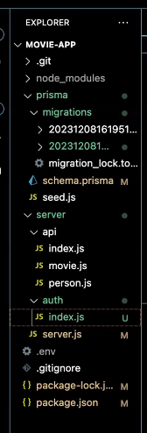
Routes - folders
Index.js in the different folders acts as a switchboard for all the files in that folder

Slide 19
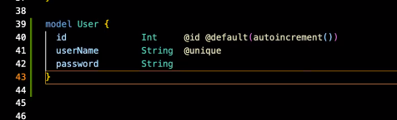
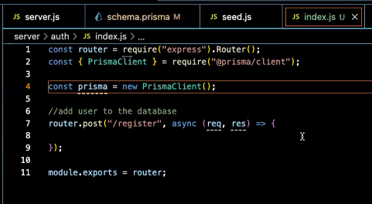
Authentication
Under server folder
Create auth folder
Inside auth folder
create index.js

Slide 20
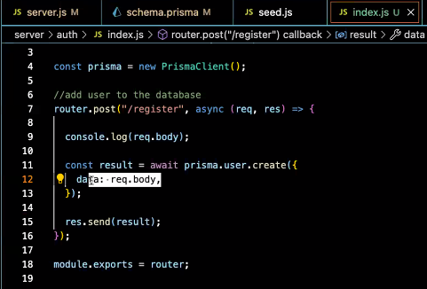
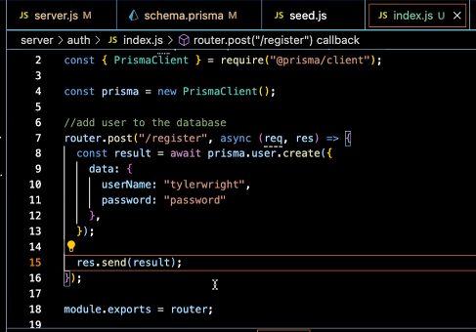
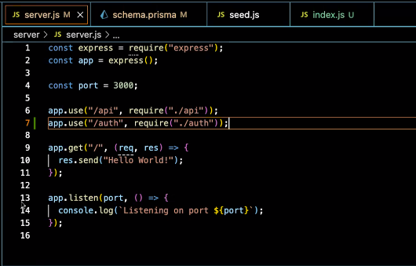
Authentication
Takes body and creates data
Seed.js
Test data
Server.js
Server.js

Slide 21
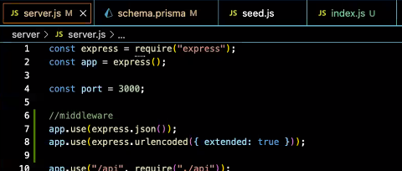
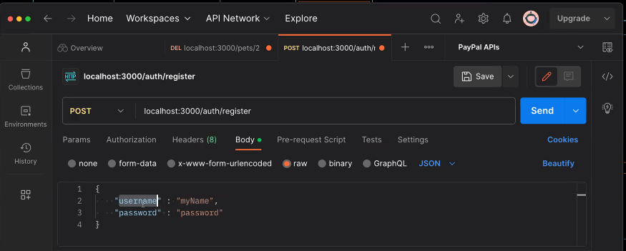
Authentication
Need to get info from the body of the request:
NEEDS MIDDLEWARE
Server.js
Test in postman

Slide 22
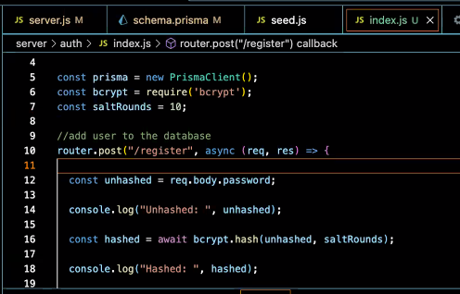
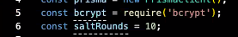
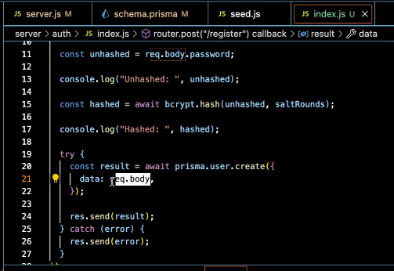
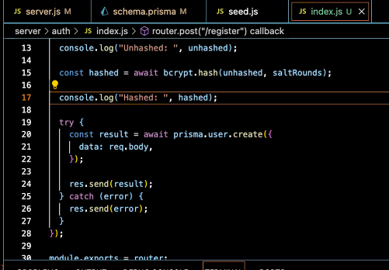
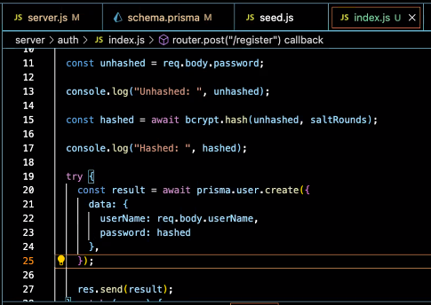
Authentication - bcrypt
Npm install bcrypt
Auth/Index.js

Slide 23
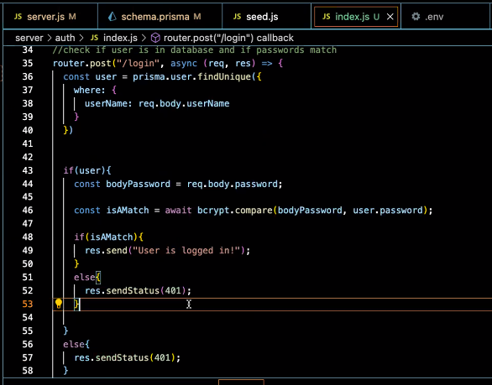
Authentication - bcrypt
Compare username and password to database
Need to add await on line 36

Slide 24
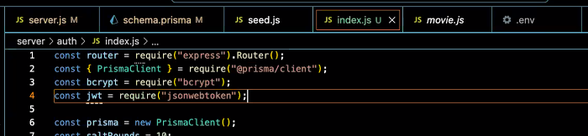
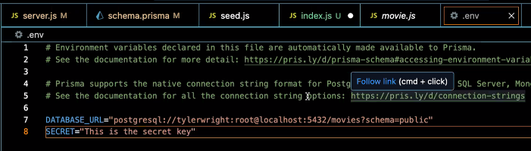
Authentication - tokens
Npm install jsonwebtoken
Npm install dotenv
Auth/Index.js
In the .env file:

Slide 25
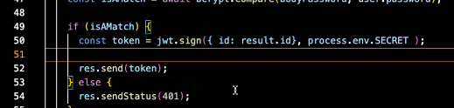
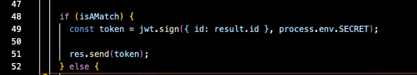
Authentication - tokens
Auth/Index.js
examples

Slide 26
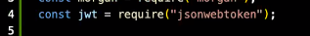
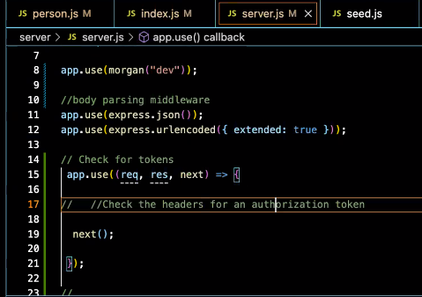
Authentication - tokens
Add this to top
In server.cjs:
//check for tokens
App.use((req,res,next) => {
// check headers for auth token
Next();
});
The “next” here says I’m done with this stuff, send it on to the next thing

Slide 27
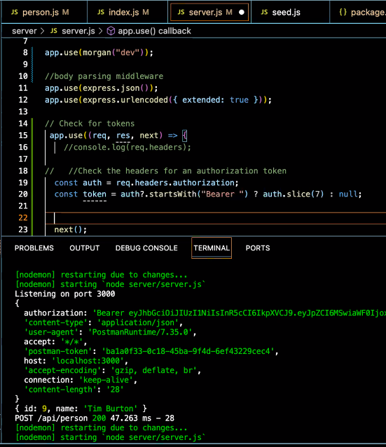
Authentication - tokens
In server.cjs:
//check for tokens
App.use((req,res,next) => {
// check headers for auth token
Const auth = req.headers.authorization;
const token = auth?.slice.startsWith("Bearer ")? auth.slice(7) : null;
Next();
});
The slice is because we don’t want the bearer part of the beginning included
The ? Is a shortcut that says if it exists… the :null says if there is no token, then token = null

Slide 28
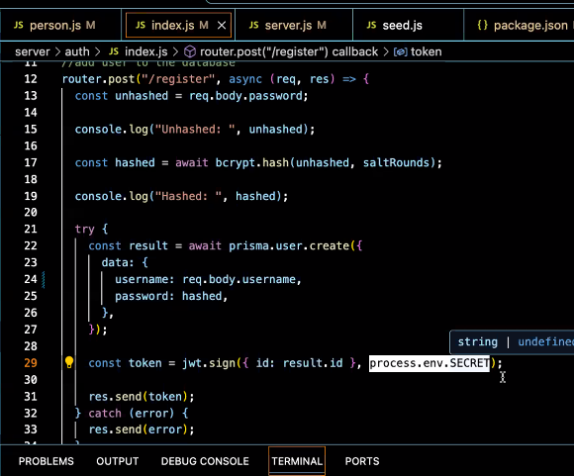
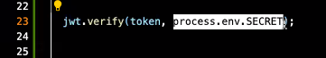
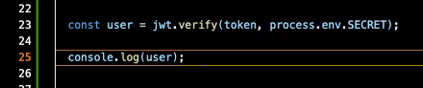
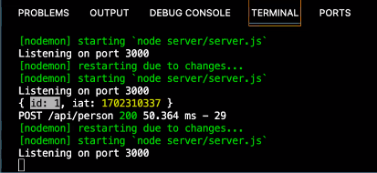
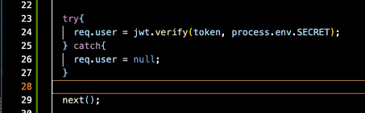


Authentication - tokens
This compares the token and returns the user ID or null
This returns the id of the user
Final form

Slide 30
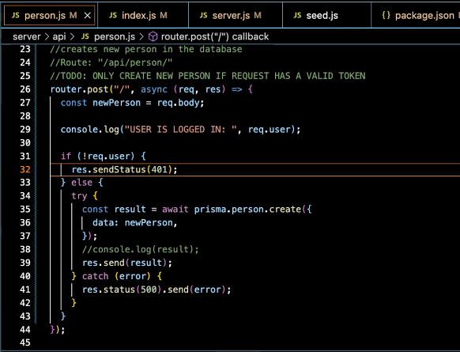
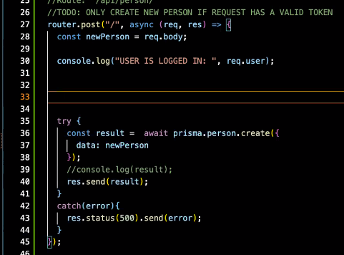
Authentication - tokens
If user is not authorized, they cannot proceed
Req.user --- this is where the response from the compare comes in

Slide 35
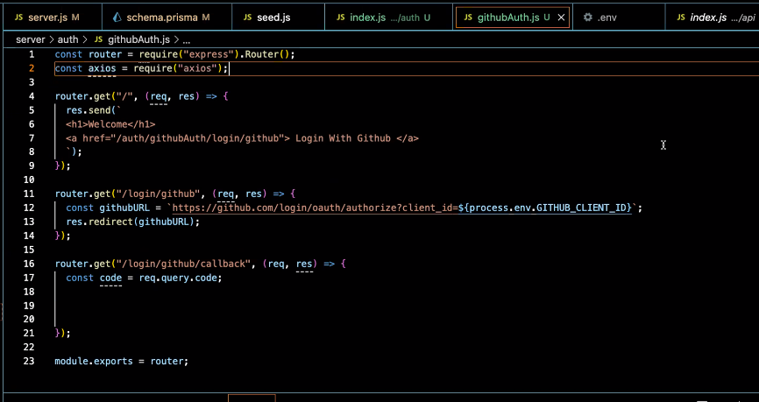
Authentication - oauth
Npm install axios
Require axios

Slide 36


Authentication - oauth

Slide 37






Authentication - oauth
In github

Slide 38



Authentication - oauth
Server.js route to github
Auth/githubAuth.js

Slide 39


Authentication - oauth

Slide 40

Authentication - oauth
githubauth.js
Create route for the callback (given / supplied to github

Slide 42

Front End Connection
Npm run build
Once built, it is a static file…. Need to rebuild to see changes
__dirname connect server.js to client/index.html
Optional installation makes paths easier to write
Npm install path
Const path = require(path);

Slide 43


Slide 44

This is a proxy server
It allows you to run vite, and still make server calls without having to rebuild

Slide 45

Use fetch to get information

